Slide 1
RacerD: Compositional Static Race Detection
SAM BLACKSHEAR, Facebook, USA
NIKOS GOROGIANNIS, Facebook, UK and Middlesex University London, UK
PETER W. O’HEARN, Facebook, UK and University College London, UK
ILYA SERGEY, Yale-NUS College, Singapore and University College London, UK
Presented by Kenneth Lamar

Slide 2
Concurrent programming is hard
Concurrent programming is essential for high performance on modern multiprocessors
Multiple threads execute and interact in nondeterministic ways
The order of execution of instructions between threads is known as an interleaving
There are many possible interleavings
Some bugs will only appear in specific interleavings
Adding instrumentation or running a debugger changes thread timings
Nondeterminism makes bugs hard to find and fix

Slide 3
Data races
Data races are a common class of concurrency bugs
Occur when an unsynchronized memory access occurs between two threads, where at least one thread performs a write
Multiple threads “race” to access the memory location first
Can result in torn reads, where you read part of an old object and part of a new object
Access to shared memory must be synchronized
Typically handled using mutual exclusion locks
When a thread holds a lock, it becomes the only thread allowed to access the memory locations associated with the lock
Notes:
Torn reads occur when a writer is overwriting an object while you are reading it. You may read part of the old object and part of the new object. This is effectively a garbage and inconsistent value.

Slide 4
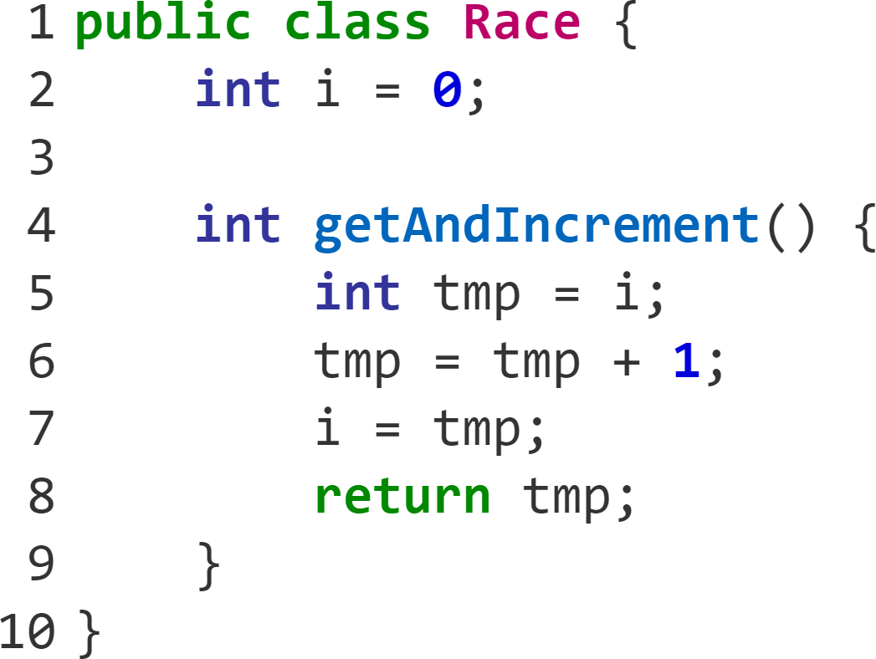
Example data race
 | T1 | T2
1 | int tmp = i; (0)
2 |  | int tmp = i; (0)
3 |  | tmp = tmp + 1;
4 |  | i = tmp; (1)
5 | tmp = tmp + 1;
6 | i = tmp; (1)
7 | return tmp; (1)
8 |  | return tmp; (1)
Notes:
For 2 threads with shared access to the same instance of this class.
Line 1 and 2: Both threads read i. No race occurs because they are both reads.
Line 4 and 6: Both threads write to i, which is a data race. They both attempt to write 1.
There is a data race on line 7, as we have 2 threads attempting to write to i without any synchronization mechanism.
Note how we attempted to increment twice, but i is now 1.
This is incorrect behavior, and the data race hints at this.
Execution is nondeterministic, so this could sometimes work properly.
We want a tool that can identify and report these data races.

Slide 5
Race Detection
Notes:
Race detection really is our core problem.

Slide 6
Case Study: Facebook News App Tool
Requirements: A race detector that:
Related Works
Scales to millions of lines of code
No code annotations needed
Usable in production
Little to no false positives
Case study drives the solution
Existing static tools are slow
Dynamic tools have poor code coverage
Small changes must re-evaluate everything
Too many false positives
Research tools see little use in production
Notes:
Want to convert sequential code to parallel equivalent for a performance boost
Fast and usable in code integration platforms
Must integrate with existing Facebook app codebase
Minimize false positives and provide descriptive bug reports
Focus on high confidence data races. Can make compromises in accuracy to achieve these goals
Slow but thorough
Fast but poor code coverage
Not practical for use in code integration platforms
Emphasis on soundness results in many false positives
Focus on identifying all races, not presenting them accessibly. Should provide more context for the bug

Slide 7
Solution: RacerD Race Detector
High confidence: Only identify easy-to-detect data races
Compositional: Reuse analysis from unchanged code
Static: Better code coverage than dynamic
Notes:
High confidence: Focus on easy-to-detect data races and ignore others
Compositional: After the initial analysis, only analyzes changed code. Instead of evaluating interleavings, it evaluates each method sequentially in isolation.
Static: Better code coverage than dynamic approaches. Misses fewer bugs

Slide 8
Contributions
Open-source RacerD tool
Used daily in Facebook CI (Continuous Integration)
2,500 issues in 6 months
Helped make Facebook News app parallel
Scroll performance up 5%
Evaluation against other race detectors
Faster than static analysis
Reports more bugs than dynamic analysis
Significantly fewer false positives
Notes:
Tool is provided open-source
2,500 analyzer issues detected over a 6-month period at Facebook, most being regressions
Improved scroll performance by over 5%, even though News is already highly optimized

Slide 9
Approach

Slide 10
Race identification
Perform static analysis on each public method to generate access snapshots
For each pair of access snapshots:
RacerD reports a data race if all of the following conditions hold:
Accesses are to the same syntactic path
At least one of the accesses is a write
At least one of the accesses is not protected by a lock
At least one of the accesses runs on a different thread
Neither access is to thread-local memory
Notes:
π: Path traveled to reach this access. Note that paths must match. Even though differing paths can lead to the same memory locations, this case is ignored for simplicity.
k: Whether the access is a read or a write.
ℓ: The number of locks currently held. Note that there is an over-approximation here, as we don’t actually care which locks are held, just that there is at least one lock (hopefully) protecting access.
t: A thread type. Used to identify whether the accesses will occur on one thread or may execute concurrently with other threads.
o: The ownership value indicates whether or not the current thread has exclusive ownership to the location being accessed.

Slide 11
Access Snapshots
<Path, R/W, #Locks, Seq/Par, Local/Shared>
Path: The path taken to reach a piece of code
Used to distinguish between different instances of a variable
R/W: Access is a read or a write
Locks: Number of locks held
Seq/Par : Whether this code can run on one thread sequentially (Seq) or on multiple threads in parallel (Par)
A thread cannot race with itself
Local/Shared: Whether a thread has exclusive (Local) or Shared ownership of the object accessed

Slide 12
Example Analysis
Recall: <Path, R/W, #Locks, Seq/Par, Local/Shared>
All Required Conditions
Accesses are to the same syntactic path
At least one of the accesses is a write
At least one of the accesses is not protected by a lock
At least one of the accesses runs on a different thread
Neither access is to thread-local memory
<i, R, 0, Par, Shared>
<i, R, 0, Par, Shared>
<i, R, 0, Par, Shared>
<tmp, W, 0, Par, Local>
<tmp, R, 0, Par, Local>
Real Data Races!
<i, R, 0, Par, Shared>
<i, W, 0, Par, Shared>
<tmp, W, 0, Par, Local>
<tmp, R, 0, Par, Local>
<i, W, 0, Par, Shared>
<i, W, 0, Par, Shared>
<i, W, 0, Par, Shared>
<tmp, R, 0, Par, Local>
Notes:
Same example as before, as evaluated by the tool.
π: Path traveled to reach this access. Note that paths must match. Even though differing paths can lead to the same memory locations, this case is ignored for simplicity.
k: Whether the access is a read or a write.
ℓ: The number of locks currently held. Note that there is an over-approximation here, as we don’t actually care which locks are held, just that there is at least one lock (hopefully) protecting access.
t: A thread type. Used to identify whether the accesses will occur on one thread or may execute concurrently with other threads.
o: The ownership value indicates whether or not the current thread has exclusive ownership to the location being accessed.
Here are all of our access snapshots created by the getAndIncrement() method.
We can quickly weed some of these out.
Let’s consider tmp first
We are assuming all threads have the same syntactic path to tmp.
Some of these operations are writes.
None of the accesses are protected by locks.
Because this code isn’t exclusive to one thread, it could be accessed by multiple threads in parallel.
tmp is thread-local. Each instance of tmp is unique to each thread, so a race cannot occur.
Now consider what remains, i.
Just a read and a write.
Let’s compare each pair.
You have to compare each summary to itself, since multiple threads could call from the same context.
Neither of these accesses is is a write, so this one isn’t a race.
Let’s go through these other two.
Since all of these hold true, both situations are data races.

Slide 13
Performance Evaluation

Slide 14
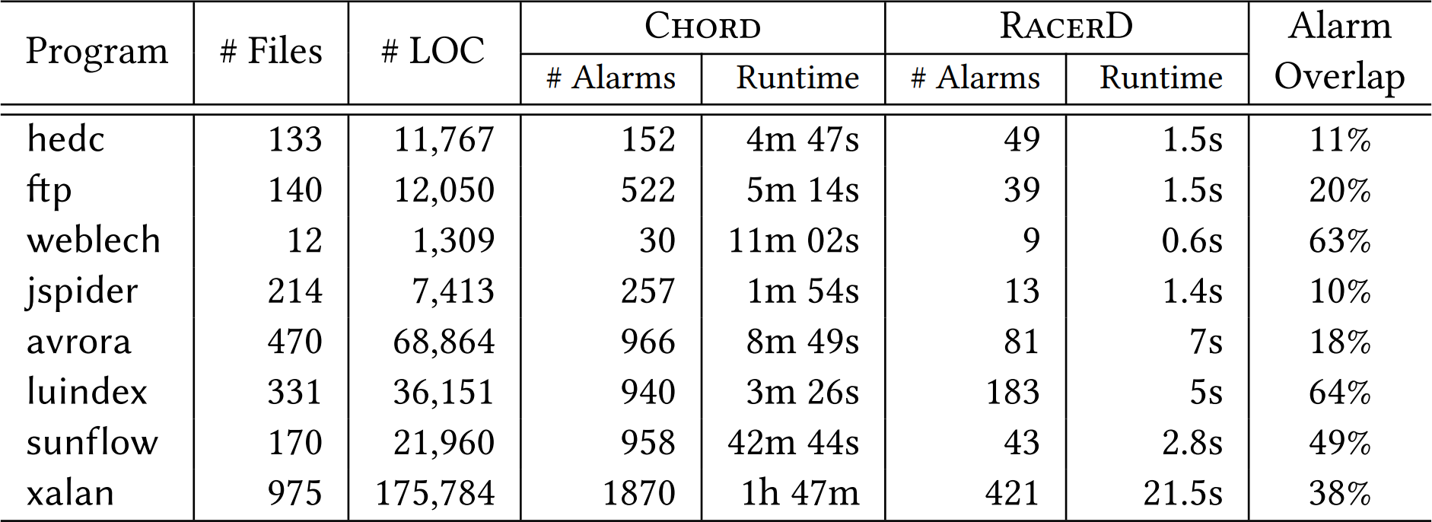
Static Performance Comparison
Notes:
Chord is the only known Java static race detector.
We check the number of races detected, regardless of whether or not they are real.
We measure execution time to complete the analysis.
Alarm overlap reports what percentage of all identified races were the same.
Key takeaways: RacerD reports at least 3 times less frequently.
At least an order of magnitude faster than Chord in all cases.
Comparable precision on manually examined races.
Superior alarms/minute rate with RacerD.
Not even considering that RacerD supports incremental code changes.

Slide 15
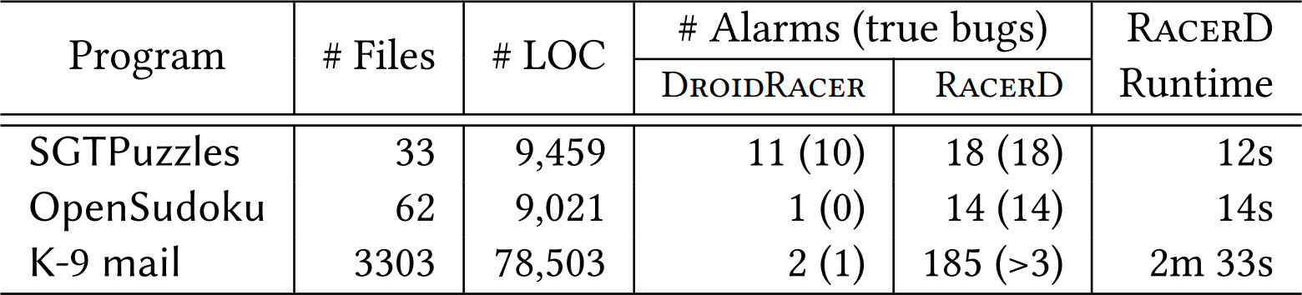
Dynamic Performance Comparison
Notes:
DroidRacer is a state-of-the-art dynamic race detector
We compare alarms once again, but this time evaluate which are true bugs too.
Note how RacerD reports no false positives, unlike DroidRacer.
>3 because the authors couldn’t be bothered to check them all.
RacerD reports twice as many data races in all cases
Runtimes were not compared because the researchers couldn’t actually get DroidRacer running themselves. They just compared against the numbers in the DroidRacer paper.

Slide 16
Limitations
Careful approximations with emphasis on:
Speed
High confidence races
Common mistakes
Easy to break if you try to defeat it
Hard to break when developing
Java only
Only locks
Lock abstraction
Object ownership
Notes:
Ignores more advanced concurrency mechanisms like atomic and volatile variables. Justified, as that code changes infrequently anyway.
Keeps track of how many locks are held, not which locks are held. If locks held have no overlap, a race can still occur.
If a thread has exclusive access to an object, it assumes all objects referenced by that object are also owned exclusively.

Slide 17
Conclusions
Concurrent programming is hard
Data races are common
RacerD is a fast, high confidence, compositional static analysis tool
Scales to millions of lines of code
Designed for use in production
A new sweet-spot in race detection tools

